Slide 1
Software Engineering – I (CSC291)
Lecture 02
Process Models

Slide 2
Topics Covered
Steps in Software Development Process
Software process Models
Sequential Process Model:
Waterfall Model
Incremental Model
V-Model
Evolutionary Development:
Prototyping
The Spiral Model
Agile Process Model:
RUP
RAD
Process iteration
Agile SDLC Models

Slide 3
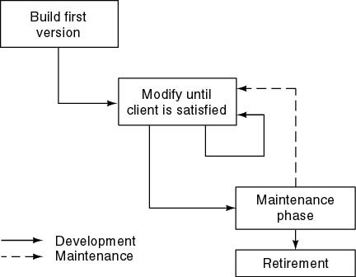
Build and Fix Model
Problems
No specifications
No design
Totally unsatisfactory
Need a life-cycle model
Phases
Milestones

Slide 4
What is a Software Process?
Software Process: “The systematic approach that is used in software engineering is sometimes called a software process.”
“A set of activities whose goal is the development or evolution of software”.
Generic activities in all software processes are:
Software specification
Software development:
Software validation:
Software evolution:

Slide 5
Activities in Software Process?
Generic activities in all software processes are:
Software Specification - what the system should do and its development constraints
where customers and engineers define the software that is to be produced and the constraints on its operation
Software Development - production of the software system
where the software is designed and programmed
Software Validation - checking that the software is what the customer wants
where the software is checked to ensure that it is what the customer
requires.
Software Evolution - changing the software in response to changing demands
where the software is modified to reflect changing customer and market requirements.

Slide 6
The Software Process (Simplified)
Feasibility and Planning
Requirements
Design Implementation
Operation and Maintenance

Slide 7
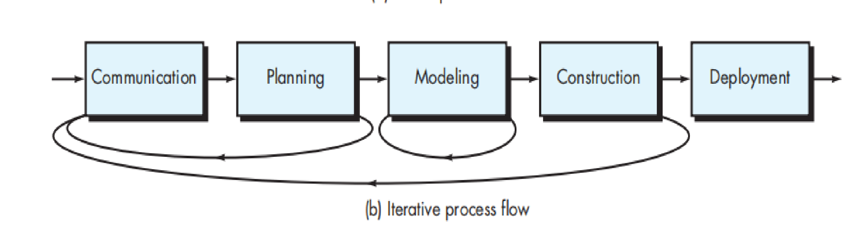
Iterative Process Flow

Slide 8
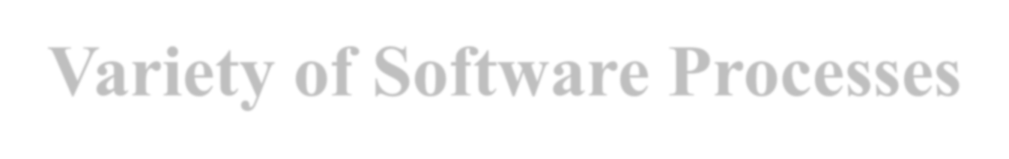

Software Process
Fundamental Assumption:
Good processes lead to good software
Good processes reduce risk
Good processes enhance visibility
Good processes enable teamwork
Variety of Software Processes
Software products are very varied. Therefore, there is no standard process for all
software engineering projects
BUT successful software development projects always need to address similar issues. This creates a number of process steps that should be part of all software projects.

Slide 9
Basic Process Steps in all Software Development
1- Feasibility and Planning
2- Requirements
3- System and Program design
4- Implementation
5- Acceptance and Release
These steps may be repeated many times during the development cycle.
6- Operation and Maintenance

Slide 10
Process Step-1: Feasibility
A feasibility study precedes the decision to begin a project.
What is the scope of the proposed project?
Is the project technically feasible?
What are the projected benefits?
What are the costs, Numerable?
Are the resources available?
What are the risks and how can they be managed?
A feasibility study leads to a decision: go or no-‐go.

Slide 11
Process Step-2: Requirements
Requirements define the function of the system from the client's viewpoint.
The requirements establish the system's functionality, constraints, and goals by consultation with the client, customers, and users.
They must be developed in a manner that is understandable by both the client and the development staff.

Slide 12
Process Step-2: Requirements
This step is occasionally divided into:
Requirements Gathering
Requirements Analysis
Requirements Definition
Requirements Specification
The requirements may be developed in a limited manner , or may emerge incrementally.
Failure to agree on the requirements and define them adequately is one of the biggest cause of software projects failing.

Slide 13
Process Step-3: System Design
Design describes the system from the software developers' viewpoint
System design:
Establish a system architecture, both hardware and software, that matches the
requirements
Program design:
Represent the software functions in a form that can be transformed into one or more executable programs
Preliminary user testing is often carried out as part of the design step.
Models are used to represent the requirements, system architecture, and program design.

Slide 14
Process Step-4: Implementation
Implementation (coding)
The software design is realized as a set of programs or program units.
These software components may be written by the development team, acquired from elsewhere, or modified from existing components.
Program testing
Program testing by the development staff is an integral part of implementation.
Individual components are tested against the design.
The components are integrated and tested against the design as a complete system.

Slide 15
Process Step-5: Acceptance and Release
Acceptance testing
The system is tested against the requirements by the client, often with selected customers and users.
Delivery and release
After successful acceptance testing, the system is delivered to the client and released into production or marketed to customers.

Slide 16
Process Step-6: Operation and Maintenance
Operation:
The system is put into practical use.
Maintenance:
Errors and problems are identified and fixed.
Evolution:
The system evolves over time as requirements change, to add new functions, or adapt to a changing technical environment.
Phase out:
The system is withdrawn from service.
This is called the Software Life Cycle

Slide 17
Sequence of Process Steps
Every software project will include these basic processes, in some shape or form, but:
The steps may be formal or informal
The steps may be carried out in various sequences

Slide 18
Sequence of Process Steps
Major alternatives
We will look at three categories of software development processes:
Sequential:
As far as possible, complete each process step before beginning the next. Waterfall model.
Iterative:
Go quickly through all process steps to create a rough system, then repeat them to improve the system. Iterative refinement.
Incremental:
A variant of iterative refinement in which small increments of software are placed in production (sprints). Agile development.

Slide 19
Software Process Models Heavyweight and Lightweight Software
Development

Slide 20
Heavyweight and Lightweight Software Development
In a heavyweight process, the development team works through the process steps slowly and systematically, with the aim of fully completing each process step and deliverables for that step that will need minimal changes and revision.
Example: Modified Waterfall Model
In a lightweight process, the development team releases working software in small increments, and develops the plans incrementally, based on experience. Each increment includes all the process steps. There is an expectation that changes will be made based on experience.
Example: Agile Software Development

Slide 21
Deliverables
Deliverables
A deliverable is some work product that is delivered to the client.
In a heavyweight process, each process step creates a deliverable, usually documentation,
e.g., a requirements specification.
In a lightweight process, the deliverables are incremental working code, with minimal supporting documentation.

Slide 22
Software Process Models

Slide 23
Software Life-Cycle Models
Life-cycle model (formerly, process model)
SDLC Model: A framework that describes the activities performed at each stage of a software development project.

Slide 24
What is a Software Process Model?
“A simplified representation of a software process, presented from a specific perspective”.
Generic process models:
Waterfall
Evolutionary development
Component-based software engineering
Iterative development

Slide 25
Sequential Models: Waterfall Model

Slide 26
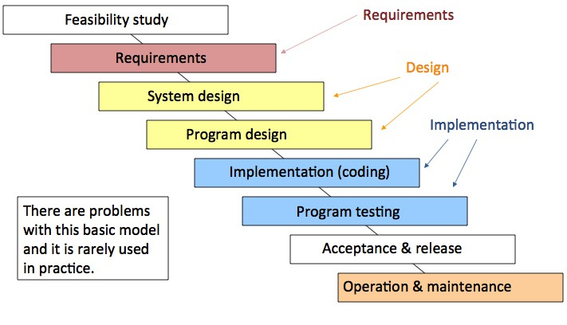
Sequential Model: Waterfall Model

Slide 27
Waterfall Model Phases
Requirements analysis and definition
System and software design
Implementation and unit testing
Integration and system testing
Operation and maintenance
The main drawback of the waterfall model is the difficulty of accommodating change after the process is underway. One phase has to be complete before moving onto the next phase.

Slide 28
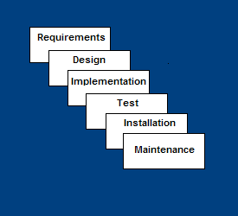
Waterfall Model
Requirements – defines
needed information, function, behavior,
performance and interfaces.
Design – data structures, software architecture, interface representations, algorithmic details.
Implementation – source code, database, user documentation, testing.

Slide 29
Waterfall Model
Test – check if all code modules work together and if the system as a whole behaves as per the specifications.
Installation – deployment of system, user-training.
Maintenance – bug fixes, added functionality (an on-going process).

Slide 30
The Water Fall Model
Advantages
Disadvantages
Easy to understand, easy to use
Provides structure to inexperienced staff
Milestones are well understood
Sets requirements stability
All requirements must be
known upfront
Difficult for the customer to
state all requirements
explicitly
Integration is one big bang
at the end
Little opportunity for
customer to preview the
system (until it may be too late)
Good for management control (plan, staff, track)
CUI-Software Engineering Concepts-CSC291-FALL-2024
Riaz Abbasi
Dr. Tehseen

Slide 31
When to use Water Fall Model
Requirements are very well known
When it is possible to produce a stable design
E.g. a new version of an existing product
E.g. porting an existing product to a new platform.

Slide 32
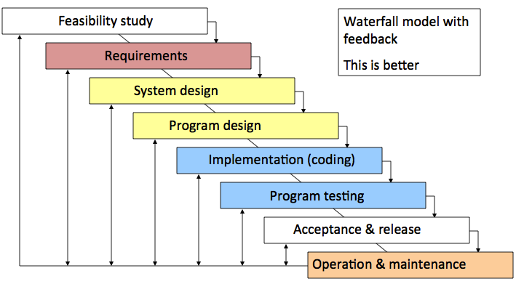
Modified Waterfall Model
CUI-Software Engineering Concepts-CSC291-FALL-2024
Riaz Abbasi
Dr. Tehseen

Slide 33
Sequential Models: Incremental Process Model

Slide 34
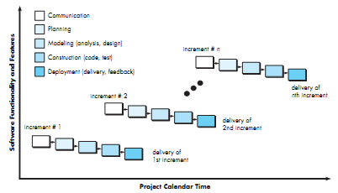
Incremental Process Model

Slide 35
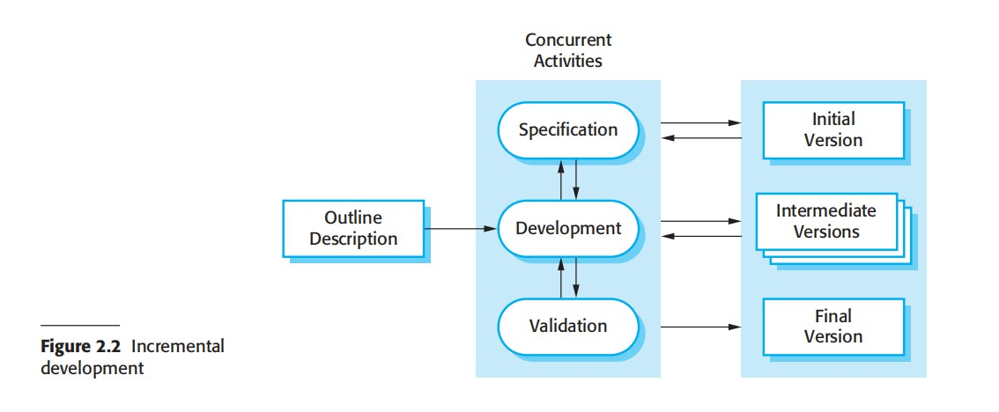
Incremental Process Model

Slide 36
Incremental Process Model
Combines elements of the waterfall model applied in an iterative fashion.
Incremental applies linear sequences as the calendar time progress.
Limited software functionalities and expands functionalities in later software release.

Slide 37
Incremental Model
Each linear sequence produces a deliverable increment of the software
E.g. Word processing software
First increment is often a core product
Basic requirements are addressed, but many supplementary remains undelivered.
Customers evaluate this core product, and the next increment is planned based on suggestions and next set of features
The plan addresses the modification of core product and delivery of additional features and functionalities.
Process is repeated until complete product is produced.

Slide 38
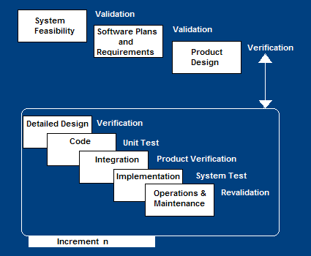
Incremental Model
Construct a partial implementation of a total system
Then slowly add increased functionality
The incremental model prioritizes requirements of the system and then implements them in groups.
Each subsequent release of the system adds function to the previous release, until all designed functionality has been implemented.

Slide 39
Incremental Model Strengths
Develop high-risk or major functions first
Each release delivers an operational product
Customer can respond to each build
Uses “divide and conquer” breakdown of tasks
Lowers initial delivery cost
Initial product delivery is faster
Customers get important functionality early
Risk of changing requirements is reduced

Slide 40
Incremental Model Weaknesses
Requires good planning and design
Requires early definition of a complete and fully functional system to allow for the definition of increments
Well-defined module interfaces are required (some will be developed long before others)
Total cost of the complete system is not lower

Slide 41
Incremental Model
Advantages
Disadvantages
Generates working software
Needs good planning and design.
Needs a clear and complete
quickly and early during the software life cycle.
It is easier to test and debug during a smaller iteration.
Customer can respond to each built.
Lowers initial delivery cost.
Easier to manage risk because
risky pieces are identified and handled during iteration.
definition of the whole
system before it can be
broken down and built
incrementally.
Total cost
is higher
than waterfall.
CUI-Software Engineering Concepts-CSC291-FALL-2024 Dr. Tehseen
Riaz Abbasi

Slide 42
When to use the Incremental Model
Risk, funding, schedule, program complexity, or need for early realization of benefits.
Most of the requirements are known up-front but are expected to evolve over time
A need to get basic functionality to the market early
On projects which have lengthy development schedules
On a project with new technology
Useful when
Staff is unavailable for complete implementation and deadline is tight
If core product is well received, additional staff can implement next increment
Increment can be planned to manage technical risks
Partial functionalities can be delivered to end – user without inordinate delay.

Slide 43
Incremental development advantages
Customer value can be delivered with each increment so system functionality is available earlier.
Early increments act as a prototype to help elicit requirements for later increments.
Lower risk of overall project failure.
The highest priority system services tend to receive the most testing.

Slide 44
V-Shaped Model

Slide 45
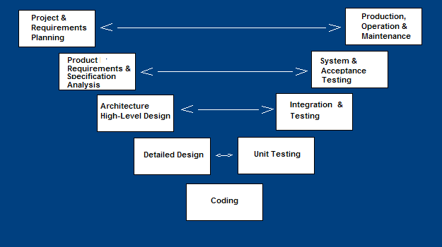
🞂​V-Shaped Process Model
A variant of the Waterfall that emphasizes the verification and validation of the product.
Testing planned
of the
in parallel
product is a of
with
corresponding development
phase

Slide 46
V-Shaped Steps
Project and Requirements Planning
Coding – transform algorithms into software
– allocate resources
Product Requirements and
Unit testing – check that each
Specification Analysis – complete
module acts as expected
specification of the software system
Integration and Testing – check that
Architecture or High-Level Design –
modules interconnect correctly
defines how software functions
fulfill the design
System and acceptance testing –
check the entire software system in
Detailed Design – develop
its environment
algorithms for each architectural
component
Production, operation and
maintenance – provide for
enhancement and corrections

Slide 47
V-Shaped Strengths
Emphasize planning for verification and validation of the product in early stages of product development
Each deliverable must be testable
Project management can track progress by milestones
Easy to use

Slide 48
V-Shaped Weaknesses
Does not easily handle concurrent events
Does not handle iterations or phases
Does not easily handle dynamic changes in requirements

Slide 49
When to use the V-Shaped Model
Excellent choice for systems requiring high reliability – hospital patient control applications
All requirements are known up-front
When design is stable
Solution and technology are known

Slide 50
Evolutionary Development

Slide 51
Evolutionary Process Model
These models are more suited to object oriented systems.
They are iterative.
They enable the software developer to develop increasingly more complex versions of the software
Like all complex systems, software evolves over a period of time and hence evolutionary models are more suited to software development.
Requirements change while software gets developed.

Slide 52
Evolutionary development
Exploratory development
Objective is to work with customers and to evolve a final system from an initial outline specification. Should start with well- understood requirements and add new features as proposed by the customer.
Throw-away prototyping
Objective is to understand the system requirements. Should start with poorly understood requirements to clarify what is really needed.

Slide 53
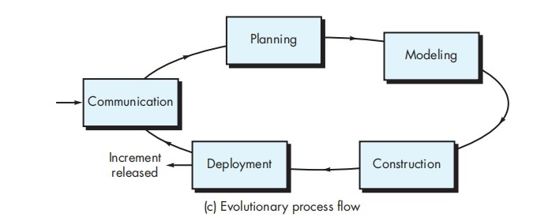
Evolutionary development

Slide 54
Evolutionary Development
Problems
Lack of process visibility;
Systems are often poorly structured;
Special skills (e.g. in languages for rapid prototyping) may be required.
Applicability
For small or medium-size interactive systems;
For parts of large systems (e.g. the user interface);
For short-lifetime systems.

Slide 55
Evolutionary Process Models
Evolutionary Process Models
Prototyping
The Spiral Model

Slide 56
Prototyping Model

Slide 57
Prototyping Model
Developers build a prototype during the requirements phase
Prototype is evaluated by end users
Developer may be unsure about efficiency of algorithm, adaptability of OS, or human-machine interaction
Users give corrective feedback
Developers further refine the prototype
When the user is satisfied, the prototype code is brought up to the standards needed for a final product.
Used as standalone Process model
Used as a technique implemented in any process model

Slide 58
Prototyping Steps
A preliminary project plan is developed
A partial high-level paper model is created
The model is source for a partial requirements specification
A prototype is built with basic and critical functions
The designer builds
the database
user interface
algorithmic functions
The designer demonstrates the prototype, the user evaluates for problems and suggests improvements.
This loop continues until the user is satisfied

Slide 59
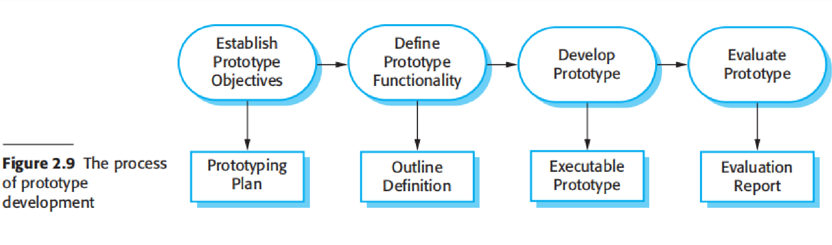
Process Of Prototype Development

Slide 60
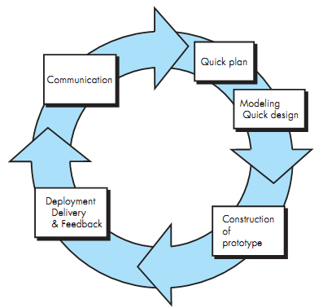
Prototype Model

Slide 61
Prototyping Strengths
Customers can “see” the system requirements as they are being gathered
Developers learn from customers
A more accurate end product
Unexpected requirements accommodated
Allows for flexible design and development
Steady, visible signs of progress produced
Interaction with the prototype stimulates awareness of additional needed functionality

Slide 62
Prototyping Weaknesses
Tendency to abandon structured program development for “code- and-fix” development
Bad reputation for “quick-and-dirty” methods
Overall maintainability may be overlooked
Process may continue forever (scope creep)
It is a thrown away prototype when the users are confused with it

Slide 63
When to use Prototyping
Requirements are unstable or have to be clarified
As the requirements clarification stage of a waterfall model
Develop user interfaces
New, original development

Slide 64
Spiral Model

Slide 65
🞂​ Spiral Model
Proposed by Barry Boehm - Evolutionary software process model
Couples Iterative nature of prototyping + waterfall model
Potential for rapid development of increasingly more complete version of software
Spiral Model - software is developed in a series of evolutionary releases.
Early iteration - Paper model / prototype (trial product)
Later increasingly more complete version of engineering software is produced

Slide 66
🞂​ Spiral Development
Process is represented as a spiral rather than as a sequence of activities with backtracking.
Each loop in the spiral represents a phase in the process.
No fixed phases such as specification or design - loops in the spiral are chosen depending on what is required.
Risks are explicitly assessed and resolved throughout the process.

Slide 67
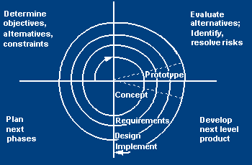
🞂​ Spiral Model
Adds risk analysis, and 4gl RAD prototyping to the waterfall model
Each cycle involves the same sequence of steps as the waterfall process model

Slide 68
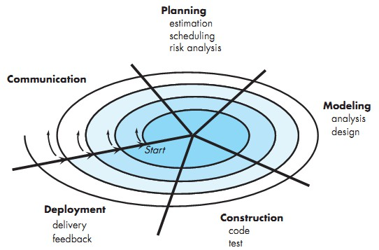
🞂​ Spiral Model

Slide 69
🞂​ Spiral Model Sectors
Objective setting
Specific objectives for the phase are identified.
Risk assessment and reduction
Risks are assessed and activities put in place to reduce the key risks.
Development and validation
A development model for the system is chosen which can be any of the generic models.
Planning
The project is reviewed and the next phase of the spiral is planned.

Slide 70
🞂​ Spiral Model
Advantage:
Disadvantage
Realistic approach of development in large scale
Developer and customer satisfaction
Reacts to risk at evolutionary level
Uses prototype - Risk reduction mechanism
Enables developer to apply prototype in any stage
Direct consideration of technical risk at all step.
Difficult to convince customers
Demands considerable risk expertise
assessment
Model has not been used as widely as the linear sequential or prototype paradigm
It is not used for small projects
CUI-Software Engineering Concepts-CSC291-FALL-2024
Riaz Abbasi
Dr. Tehseen

Slide 71
Spiral Model Strengths
Provides early indication of insurmountable risks, without much cost
Users see the system early because of rapid prototyping tools
Critical high-risk functions are developed first
The design does not have to be perfect
Users can be closely tied to all lifecycle steps
Early and frequent feedback from users
Cumulative costs assessed frequently

Slide 72
​ Spiral Model Weaknesses
Time spent for evaluating risks too large for small or low-risk projects
Time spent planning, resetting objectives, doing risk analysis and prototyping may be excessive
The model is complex
Risk assessment expertise is required
Spiral may continue indefinitely
Developers must be reassigned during non-development phase activities
May be hard to define objective, verifiable milestones that indicate readiness to proceed through the next iteration

Slide 73
When to use Spiral Model
When creation of a prototype is appropriate
When costs and risk evaluation is important
For medium to high-risk projects
Long-term project commitment unwise because of potential changes to economic priorities
Users are unsure of their needs
Requirements are complex
New product line
Significant changes are expected (research and exploration)

Slide 74
Choosing a Software Process
Changes during the software development process are expensive.
If the requirements are poorly understood, or expected to change, select a process that keeps flexibility. Iterative refinement, sprints, phased implementation.
If a big software systems has many inter-related components, avoid major changes to the design of a system during development. Sequential process, such as the modified waterfall model.
If the market for the software is poorly understood, use a process that gets operational software in front of customers as quickly as possible. Incremental, sprints.

Slide 75
Tailored SDLC Models
No single model fits all projects
If there is no suitable model for a particular project, pick a model that comes close and modify it for your needs.
If project should consider risk but complete spiral model is too much – start with spiral and simplify it
If project should be delivered in increments but there are serious reliability issues – combine incremental model with the V-shaped model
Each team must pick or customize a SDLC model to fit its project

Slide 76
Corporate Processes
Large software development organizations have their own internal processes that are designed for their needs. For example:
Amazon.com (Internet commerce) makes extensive use of sprints. Most software development is divided into increments of about four weeks elapsed time.
SAP (business software) emphasizes the functionality that is seen by their business customers. Much of the development is suitable for a sequential process.
Microsoft (PC software) places great emphasis on testing with a very wide variety of equipment and backward compatibility. Much of the development uses a spiral process.

Slide 77
​ Conclusions
Different life-cycle models
Each with its own strengths
Each with its own weaknesses
Criteria for deciding on a model include:
The organization
Its management
Skills of the employees
The nature of the product
Best suggestion
“Mix-and-match” life-cycle model

Slide 78

THANK YOU

Slide 79

THANK YOU

